Slide 1
ASSESSMENT OF SELECTED HYDROLOGICAL PROPERTIES OF SOILS IN NNAMDI AZIKIWE UNIVERSITY IFITE-OGWARI, ANAMBRA STATE, NIGERIA.
A RESEARCH PROJECT
BY:
UDOIDIONG, CYPRIAN ALPHONSUS
2016864022
SUPERVISED BY:
MR. CHIKE ONYEKA MADUEKE
DEPARTMENT OF SOIL SCIENCE
FACULTY OF AGRICULTURE
NNAMDI AZIKIWE UNIVERSITY
IFITE-OGWARI CAMPUS
IN PARTIAL FULFILLMENT OF THE REQUIREMENT FOR THE AWARD OF BACHELOR OF AGRICULTURE (B.AGRIC.) DEGREE IN SOIL SCIENCE
NOVEMBER, 2022

Slide 2
ABSTRACT
The study was conducted at Nnamdi Azikiwe University to assess some selected hydrological properties of Ifite-ogwari lowland soil. For the study, two different soil depths (0-15 and 15-30cm) were considered for the sites (upland, midslope and lowland elevation class of soils) and replicated twice. A total of 15 core samples and disturbed samples were collected and carried for laboratory analysis. Particle size distribution was carried out to ascertain the textural class of the soils and the hydrological properties considered were; bulk density, field capacity, hydraulic conductivity, total porosity and wilting point. The results obtained from the study showed no significant differences among the studied soils on its particle size distribution and soil hydrological properties. Although, lowland soils recorded a higher mean value of these parameters. Hence, lowland soils could be recommended for agricultural purposes as it indicates a positive productivity indicator.

Slide 3
INTRODUCTION
Soil is a natural body comprised of solids (minerals and organic matter), liquid and gases that occurs on the land surface, occupies space, and is characterized by one or both of the following: horizons, or layers, that are distinguishable from the initial material as a result of additions, losses, transfers, and transformations of energy and matter or the ability to support rooted plants in a natural environment (Reubens et al., 2007; Williamson et al., 2004).
Soil as an ecosystem of varied organisms, is also a stored house for water for both micro Flora and micro fauna activities. The proportion of water that can be stored in the root zone for crop use is significantly influenced by the soil particle size distribution, organic matter content, and mineralogical composition.
Both Intrinsic (environment) and extrinsic (man-related) factors can significantly influence soil properties, including its hydrological conditions (Reubens et al., 2007).

Slide 4
INTRODUCTION
Soil hydrological properties are among the most important parameters that determine soil quality and its capability to serve the ecosystem. (Ziadat and Taimeh, 2013).
Information of soil physical and hydrological characteristics are essential in the development of improved soil, water and crop management, systems. When integrated with improved crop varieties, fertilization, and plant protection, these soil characteristics can aid in the development of economically viable farming systems which can increase and stabilize agricultural production.
The purpose of determining the soil physical and hydrological characteristics for the major soils is to facilitate methodological decision - making in planning development strategies.

Slide 5
OBJECTIVE OF THE STUDY
The main objective of this study was;
To assess some selected hydrological properties of Nnamdi Azikiwe University, Ifite-ogwari, lowland soils.

Slide 6
MATERIALS AND METHODS
3.1 Site Description
Field experiment was conducted at Nnamdi Azikiwe University which is located at Ifite-Ogwari, Annex, Anambra state with the coordinate of 06°21’N and 7°61’E (National Bureau of Statistics, 2006).
3.2 Climate Description
Ifite-Ogwari has 2 climatic seasons, dry season which last from November to march and rainy season which last from April to October with an August break. During the dry period, temperature of the day ranges from 20 – 38°c resulting to increased evapo-transpiration but in rainy season, it ranges from 6 – 28°c with a lower evapo-transpiration. The annual rainfall varies from 1500 to 1650mm (Aghamelu et al, 2011). Ifite-Ogwari also has a relative humidity of 80% at dawn (hydrometrology department, Awka).
3.3 Ifite-Ogwari Geology
The geological formations that underlie Ifite-Ogwari are Imo shale and Bende Ameki formation. In the riverine and low lying areas particularly the plain west of Mamu River as far as to the land beyond the permanent Nnamdi Azikiwe University, the underlying impervious clay shales cause water-logging of the soil during rainy season. The soils of Ifite-Ogwari and Awka are generally Ultisols which are mineral soils having an argillic horizon with a base saturation of <35% when measured at pH of 5.3. The mean annual soil temperature is usually 28°c or higher.

Slide 7
3.4 Ifite Ogwari vegetation
Ifite-Ogwari lies in the forest zone with tall trees which are usually deciduous in nature having thick undergrowth and numerous climbers. The typical trees found in this region are oil palm trees, raffia palm, iroko trees, oil bear and gravelina trees. The oil palm and raffia palm tres are not deciduous in nature.
3.5 Sample collection
Before the start of the field experiment, field survey visits were conducted to generate basic data that are related with hydrological properties for this experiment. Two different depths (0-15 and 15-30 cm) was considered for the sites (upland, midslope and lowland elevation class of soils) and replicated twice based on information available for each site. Both disturbed and undisturbed samples was collected for analysis. The undisturbed samples were collected with the use of a core sampler while that of the disturbed were collected using a soil Auger. A total of 15 core samples and disturbed samples were collected each and carried to the laboratory for analysis.
3.6 Laboratory analysis
The undisturbed soil Samples collected were analyzed for some specific parameter such as Particle size distribution, saturated hydraulic conductivity, permanent wilting point, porosity, bulk density, moisture characteristics at various depths.

Slide 8
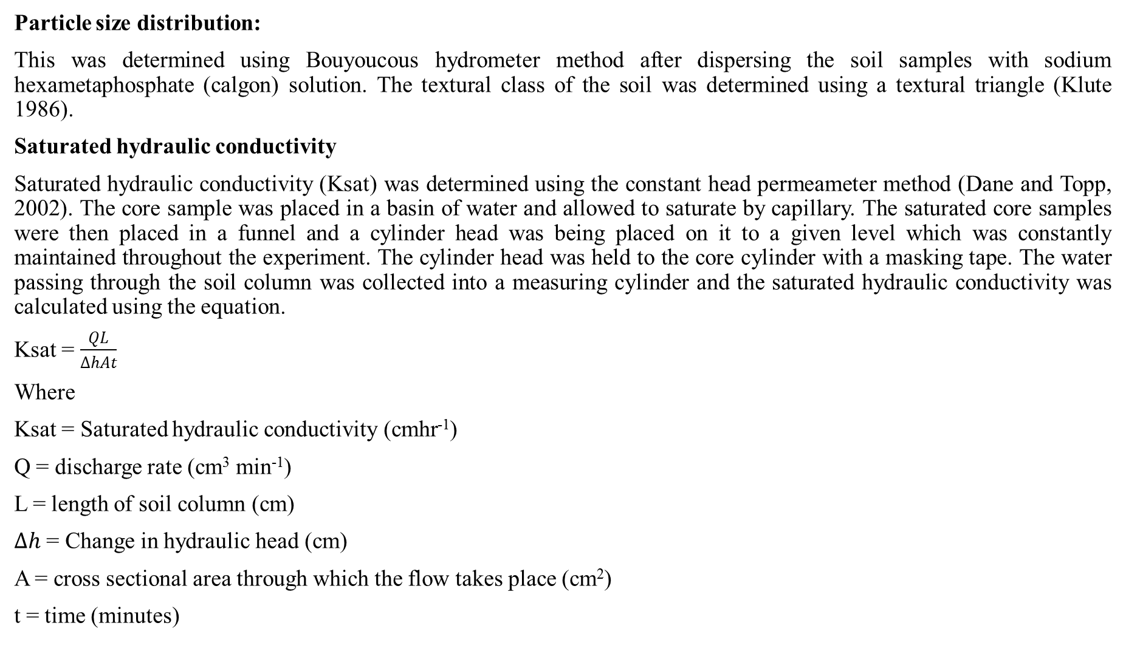

Slide 9
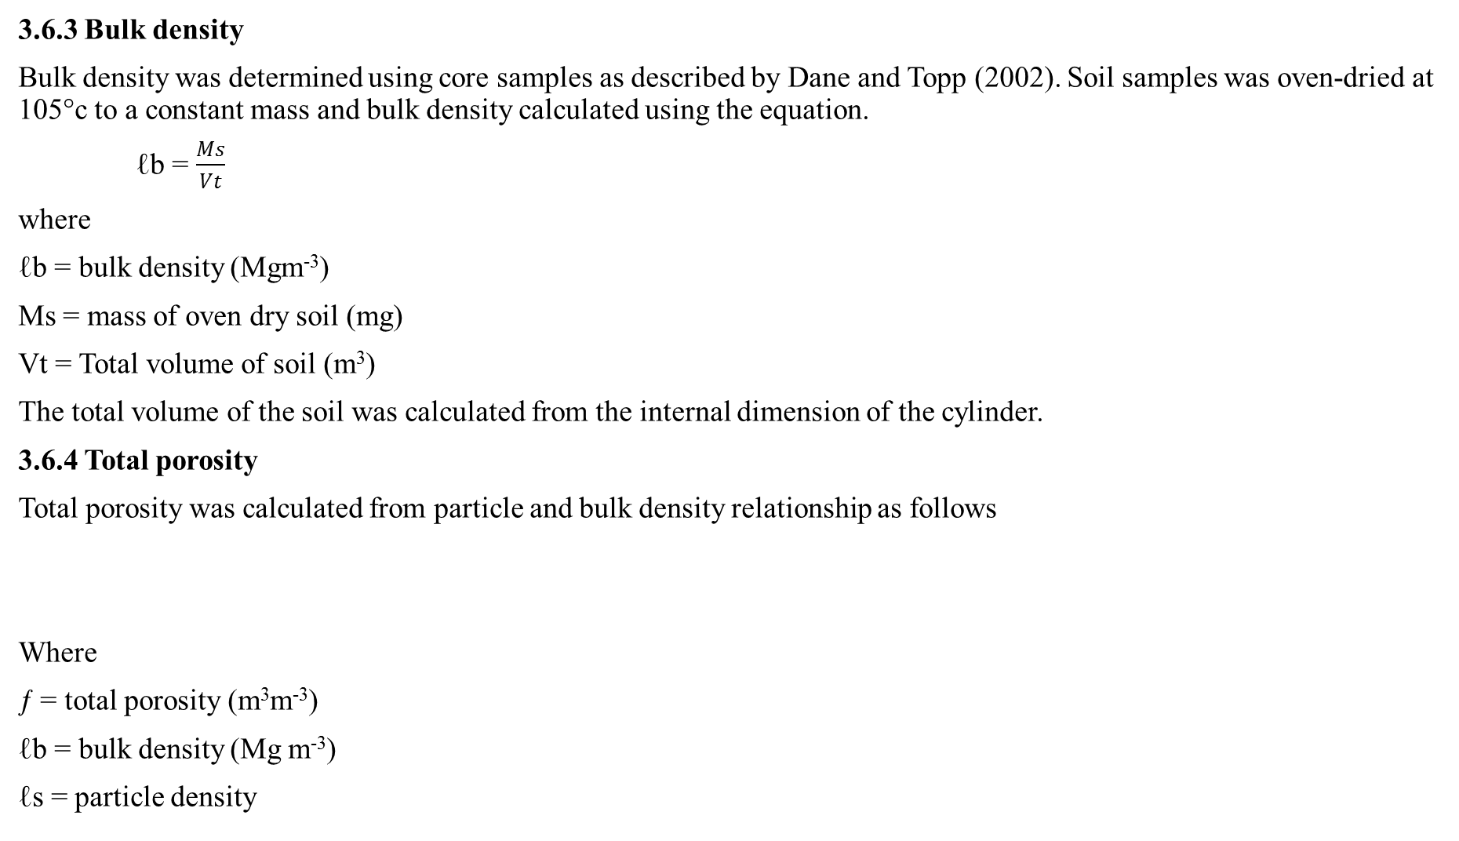
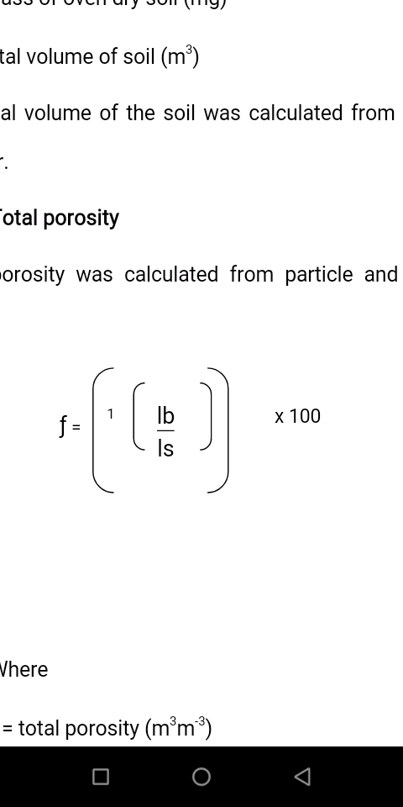

Slide 10
3.6.5 Field water capacity
Field water capacity was determined using Carter (1993) Gravimetric Method. The determination was done with the core cylinder based on the fact that “the content of water, on a mass or volume basis” remaining in a soil two (2) or three (3) days after having been wet and Subtracted from the weight of oven dried core samples and divided by Oven dried core samples weight.
3.6.7 Permanent wilting point (PWP)
Permanent wilting point was determined using Carter (1993) Gravimetric method. Where a core cylinder based on the fact that “the content of water, on a mass or volume basis” remaining in a soil 10 days and subtracted from the weight of oven dried core samples and divided by Oven dried core samples weight.
3.7 Statistical analysis
Statistical analysis of data generated was done using SPSS (Statistical Package for Social Sciences) software package version 21 and significant means were separated using fishers’ least significant differences at 5% level of significant.

Slide 11
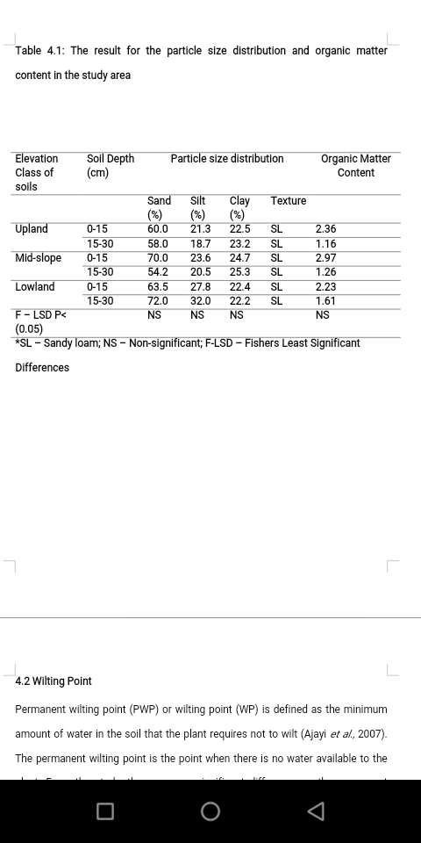
RESULTS AND DISCUSSION
Table 4.1: The result for the particle size distribution and organic matter content in the study area

Slide 12
RESULTS AND DISCUSSION
4.1 Textural Class
Texture refers to the relative proportions of particles of various sizes such as sand, silt and clay in the soil (Ajayi et al., 2007). The percentage of sand, silt and clay in the soil determines the textural class of the different soil elevation class examined. No Significant on the percentage of sand was observed among the different elevation classes (upland, mid-slop and lowland) in the study area as shown in Table 4.1. Lowland soils recorded the highest mean value (72.00%) at a soil depth of 15-30cm compared to the mid-slope elevation class which had the lowest mean value (54.2%) at the same soil depth. For silt, lowland elevation class of soil had the highest mean value (32%) at the soil depth of 15-30cm compared to the lowest mean value recorded in the upland soils (18.7%) at a same depth. For clay, the mid-slope soils in the study site had the highest mean value (25.3%) at a depth of 15-30cm compared to the lowland which had the lowest mean value (22.2%) at the same soil depth. The lowland soil was dominated by high sand fractions, very little silt and low clay percent. The soil textural class for the treatments is termed “sandy loam”. The soil type could provide a suitable environment for growth of different crop types under good management practices. The uniqueness of the soils had also been reported by some researchers (Ajayi et al., 2007; Wapa and Kwari, 2004) who identified the soils as characteristically sandy, low in active clay content, low in buffering capacity and high in Kaolinite. Eyankware et al., 2016 reported that higher increase in sand content in the lowland soil could be due to the low contents of organic carbon, organic matter, cation exchange capacity and nitrogenous component in the soil.

Slide 13
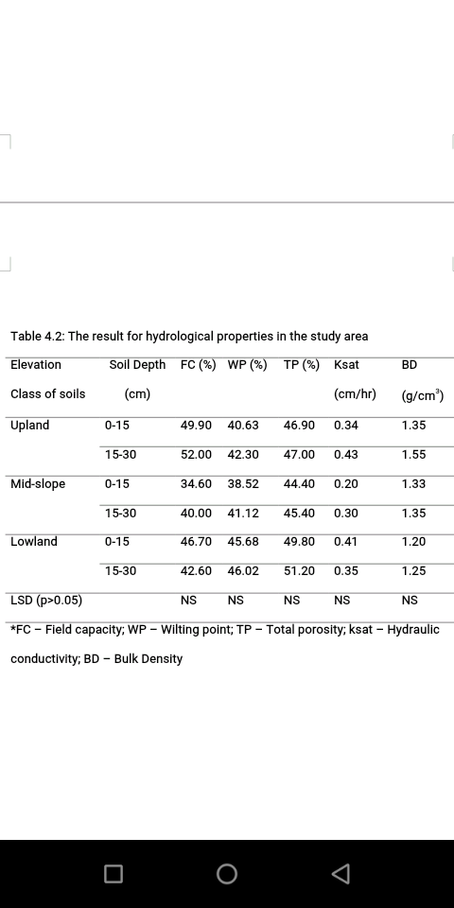
RESULTS AND DISCUSSION
Table 4.2: The result for hydrological properties in the study area

Slide 14
4.2 Wilting Point
Permanent wilting point (PWP) or wilting point (WP) is defined as the minimum amount of water in the soil that the plant requires not to wilt (Ajayi et al., 2007). The permanent wilting point is the point when there is no water available to the plant. From the study, there was no significant difference on the permanent wilting point of the studied soils. At soil depth of 15-30cm, the lowland soil had the highest mean value (46.02%) compared to the mid-slope elevation class of soil (38.52%) at a soil depth of 0-15cm. The lowland recorded highest mean value compared to the upland elevation class (42.30%) at a soil depth of 15-130cm. The moisture content at the permanent wilting point varies with soil texture and this finding is also similar to Buytaert et al., (2000). Fine-textured soils retain higher amounts of water (∼26%–32% v/v) than the coarse textured soils (10%–15% v/v) at the permanent wilting point (Buytaert et al., 2002). The higher wilting point of the lowland soil could be attributed to it textural class (sandy loam) and it is an indicator that lowlands in the study area can retain higher amount of water.
4.3 Field Capacity
Field capacity is the amount of soil moisture or water content held in the soil after excess water has been drained away and the rate of downward movement has decreased (FAO, 2016). The study, highest mean value of field capacity was recorded in the upland soils (52.0%) at a soil depth of 15-30cm, compared to the mid-slope soil (34.60%) with the lowest field capacity mean value at a soil depth of 0-15cm. The mid-slope soil field capacity was lower compared to the lowland soils (46.70%) at the depth of 0-15cm. The reason for the value of lowland soils to record such mean value may be attributed to the organic matter content in the soil, as organic matter is determinant of water retention capacity of the field and also dependent on land use or management as reported by Buytaert et al., 2002.

Slide 15
4.4 Total Porosity
Porosity is the fraction of soil that is occupied by pores. From the results, lowland elevation class of the studied soil recorded higher mean value of total porosity (51.20%) at a depth of 15-30cm compared to the mid-slope (44.40%) at the soil depth of 0-15cm. Lowland soils was also higher in total porosity mean value compared to the upland elevation class of soils (47.00%) at a soil depth of 15-30. When increase in total porosity is observed, this could be due to the increase of pores with larger diameter (macropores) associated with better soil structure (Celik et al., 2004; Rós et al., 2013). Soil organic matter influences the degree of aggregation and aggregate stability and can reduce bulk density, increase total porosity and hydraulic conductivity of heavy clay soils (Anikwe, 2000). Increase in total porosity of the lowland soils in the study area could be attributed to an increase in percentage of macro-pores and organic matter content.
4.5 Hydraulic Conductivity
Hydraulic conductivity of soil is the measure of the ability of the soil to transmit water. Upland soil of the study area recorded higher mean value of (0.43cm/hr) at a soil depth of 15-30cm compared to the lower mean value recorded by mid-slope soils (0.20cm/hr) at a soil depth of 0-15cm. The mid-slope soils were significantly lower compared to the lowland soils (0.41%) at a soil depth of 0-15cm. this report is also similar to Buytaert et al., 2002. Organic matter has beneficial effects on hydrological properties of soils such as soil hydraulic conductivity and infiltration rate (Wanas, 2002). Saturated Hydraulic conductivity of the lowland soils could be attributed to the effect of land use, management or organic matter content (Mubarak et al., 2009).

Slide 16
4.6 Bulk Density
Bulk density is the mass of the soil per unit volume of soil (volume includes both solid and pores) expressed in gramme per cubic centimeter. From the assessed soils, upland elevation class pf soils had higher mean value (1.55%) at a soil depth of 15-30cm compared to the lowland soil (1.20g/cm³) at a depth of 0-15cm. The lowland soils were significantly lower compared to the midslope soils (1.33%) at a soil depth of 0-15cm and this results coincides with Buytaert et al., 2002; 2000. According to Obi, (2000), Lower bulk density is a positive productivity indicator as it helps in easing root penetration, thereby encouraging downward movement of water through old root channels. The lower value of bulk density in lowlands could be attributed to land management or soil organic matter which influences the degree of aggregation and aggregate stability and can reduce bulk density, increase total porosity and hydraulic conductivity of heavy clay soils (Anikwe, 2000).

Slide 17
CONCLUSION AND RECOMMENDATION
5.1 Conclusion
The study was conducted to assess some selected hydrological properties of Ifite-Ogwari lowland soils. The results obtained showed that there were no significant differences among the studied soils on its particle size distribution and soil hydrological properties which includes; Bulk density, total porosity, hydraulic conductivity, field capacity and Permanent wilting point at soil depth of 0-15cm and 15-30cm. Although from the study, lowland soils recorded a higher value of these parameters.
5.2 Recommendation
From the results of the study, it could be recommended that lowland soil around the study area can be used for agricultural purpose as lowland indicates a positive productivity indicator.

Slide 18
THANK YOU!

